Slide 1


Lau Jia Win
Chua Wen Shing Bryan
Chng Kai Rong Leonard
Min Khant Ko
Gavin Ang Jun Liang
By
Team Members:

Slide 2
Agenda
Introduction
Concept & Inspirations
USP
Features
Demo
Reflections & Learning points

Slide 3
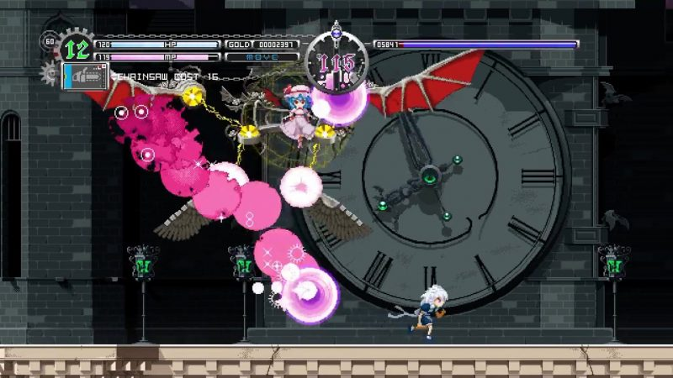
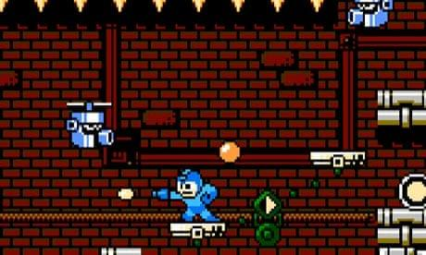
Concept and Inspirations
2D shooters and Metroidvanias
Touhou Lunar Nights
Mega-man
Notes:
(Braid, another inspiration) castlevania, hollowknight

Slide 4
Unique Selling Point
Time control mechanics in a combat focused 2D platformer
Ability to slow down time
All time except for player slowed
Consumes Solar Energy
Notes:
- Examples like Superhot and Quantum Break - 2D platformers these days like to be roguelites or soulslike and giving the player variety of different weapons or abilities that deal damage. We instead wanted to create
Player have the ability to slow down time, slowing down all movement except the player and player attacks. This applies to enemy movement, enemy projectiles, moving platforms, other physics like on boxes.

Slide 5
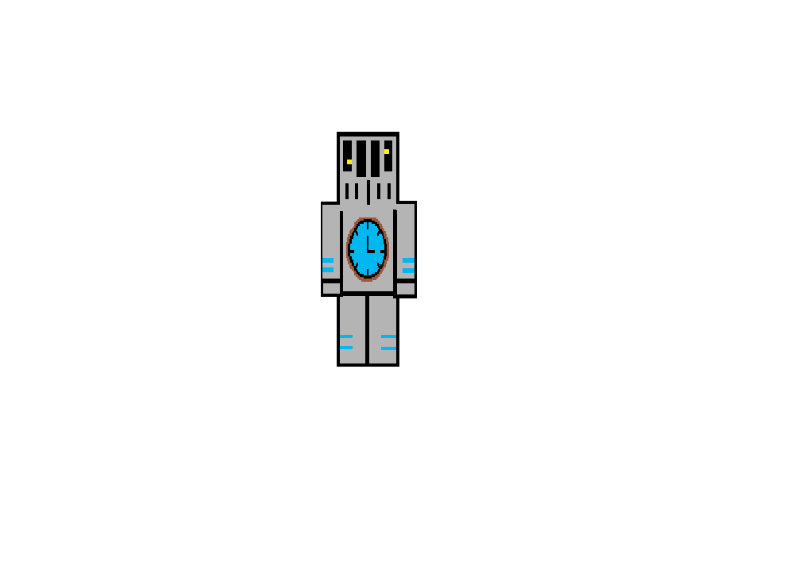

Features (Min Khant Ko)
Time slow OFF
Time slow ON
Player Character - Movement and interaction
Shooting - Charged shots - Enemy knockback
Time delay ability
Save point - Save file

Slide 6
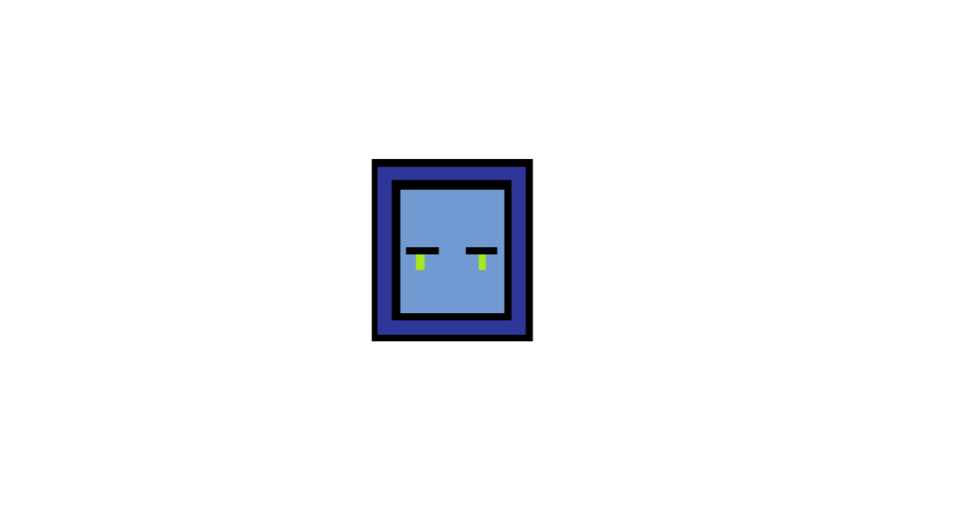



Features (Bryan)
Enemies
Basic Enemy (Melee/Range/Elite)
Boss Enemy
UI for Enemies Health
Audio Manager
Elite
Melee
Range
Boss

Slide 7
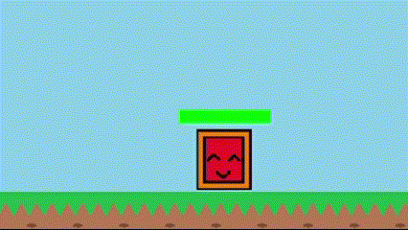
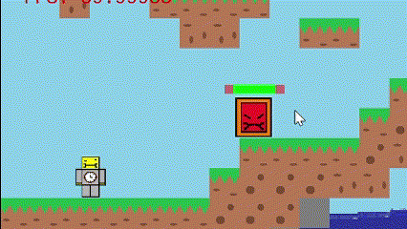
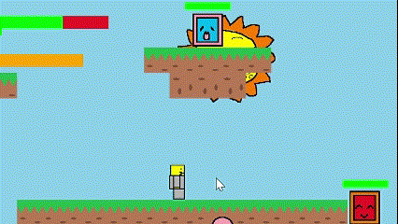
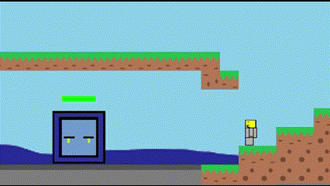
Features (Bryan)
Melee patrol
Melee aggro
Enemies
Melee
Patrols left and right
Aggros player if within certain range
Range
Does not move
Has a larger aggro range than Melee
Shoots at player when aggro
Elite
Guards a spot
Has slightly larger aggro range than Melee but less than Range
Chases the player down when aggro
Returns to original spot after player leaves aggro range
Range aggro
Elite aggro/Guard

Slide 8
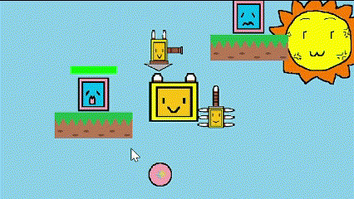
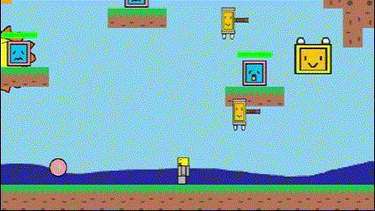
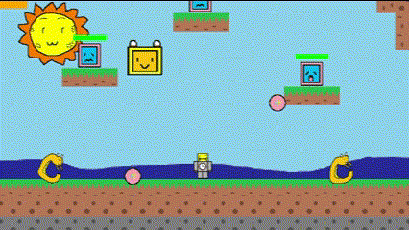
Enemies
Boss
Boss
Floats around the room
No collision with tiles
Starts attacking player once they enter boss room
Attack 1
Attack 2

Slide 9
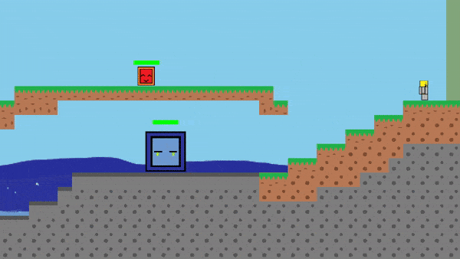
Features (Jia Win)
Game State Manager
Map
Level Design
Loading from csv file
Moving between rooms
Transition Screen
UI
Player Buffs

Slide 10
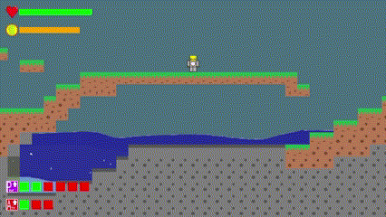
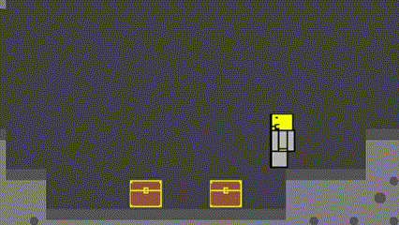
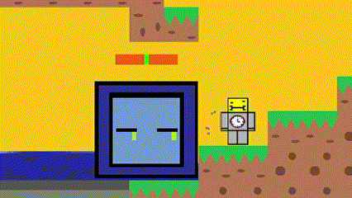
Features (Leonard)
Camera
Day & Night System
Loots
Chest
Drops
Buff
UI
Player’s Status
Pause/Controls
Buttons

Slide 11
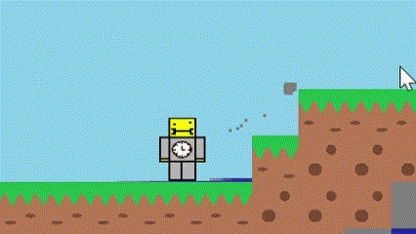
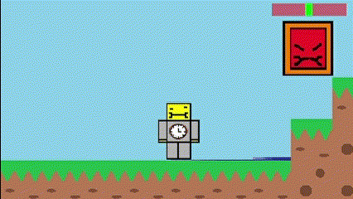
Features (Gavin)
Collision
Circle - Circle
AABB
Particle System / Manager
Game Object Manager

Slide 12
Demo
Notes:
What is game about How do different mechanics work Include gameplay Script: Start -> Starts in pause state shows controls, player can move and jump, player can shoot enemies in 2 ways, normal and charged, day night, solar energy which is used for ability only regenerates during the day We have chests that drop 1 of 3 types of buff, and the chance to spawn is random

Slide 13
Reflections & Learning points
Coding Practices
Make update functions be in own file to prevent overcrowding of main game file
Standardization of Naming Conventions
Communication
Learn to better work with different personality types
Mathematics
Modulo text height for infinite scrolling
Consistent forces for smoother motion

Slide 14
Reflections & Learning points
Perspective from non-devs
Show player more information
Need balance for new players
Notes:
Perspective from non-devs - Show player more information - Need balance for new players

Slide 15
Thank You!
Q&A

